Slide 1
Hospital Management System
The project work submitted by:
Priyanka Patel (1900290140025)
Prachi Singh(1900290140023)
Under Supervision of:
SD Mishra Sir

Slide 2
Contents of Presentation
Introduction
Objectives
Features
DFD
ERD
Technology used

Slide 3
INTRODUCTION
The project hospital management system includes registration of patients, storing their details into the system ,and also computerized billing in the pharmacy, labs.
The software has the facility to give a unique id for every patient and store the details of every patient and the staff automatically.
HMS can be entered using user name and password . It is accessible either by an administrator or receptionist.

Slide 4
OBJECTIVES
Scheduling the appointment of patient to make it convenient for both.
Scheduling the service of specialization doctors and emergency property so that facilities provided by hospital are fully utilized in effective and efficient manner.
If the medical store issues medicines to patients ,it should reduce the stock status of the medical store and vice – versa .

Slide 5
It should be able to handle the test report of patients conducted in the pathology lab of the hospital.
The information of the patients should be kept up to date and their record should be kept in the system for historical purpose .

Slide 6
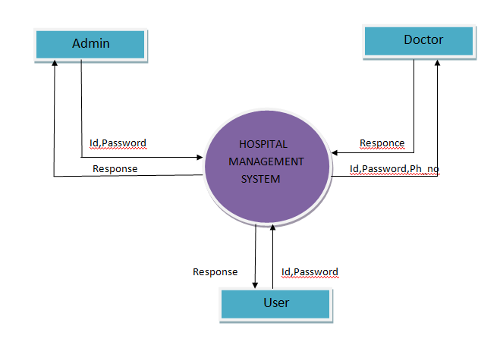
Zero level DFD

Slide 7
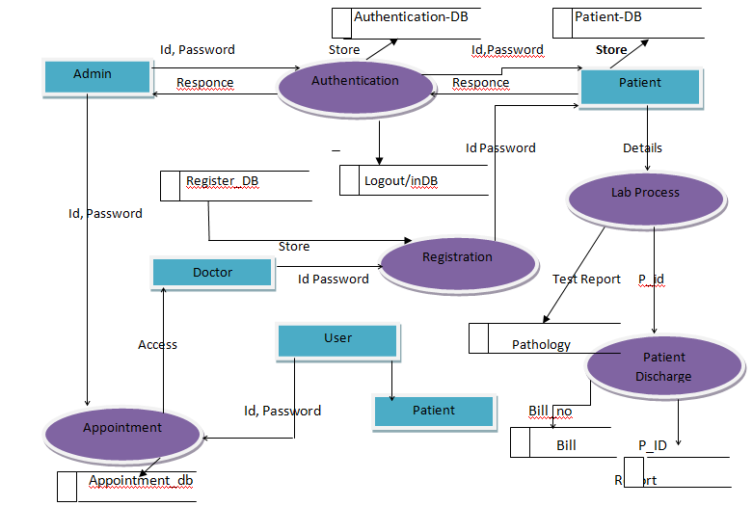
One level DFD

Slide 8
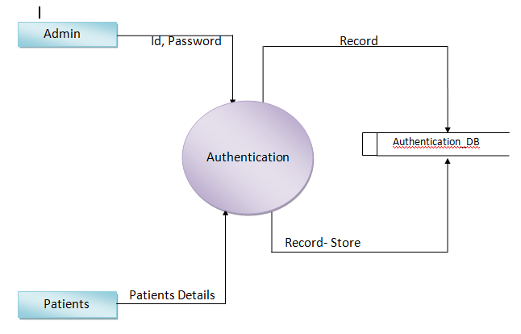
2-Dfd

Slide 9
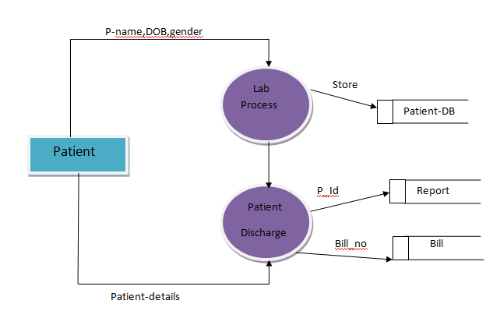
2-Dfd

Slide 10
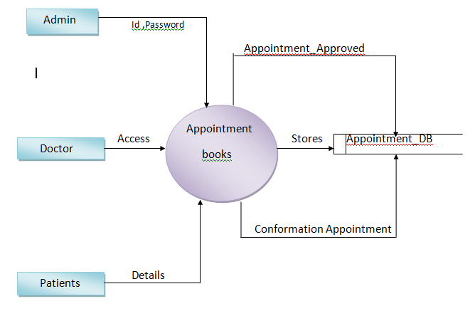
2-Dfd

Slide 11
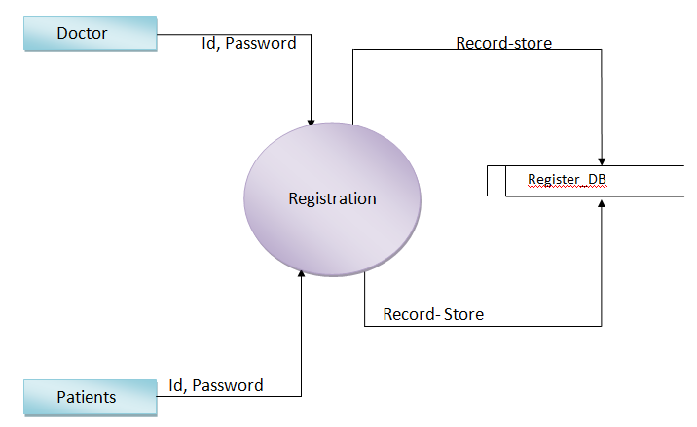
2-Dfd

Slide 12
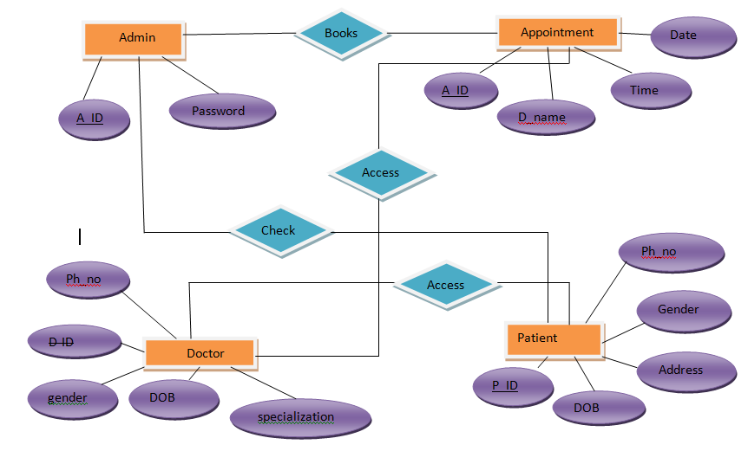
ER-Diagram

Slide 13
Technology used
Front End Technology :
* HTML
* TSH
* JAVA SCRIPT
* JSP(JAVA SERVER PAGES)
Back End Technology
* JAVA( Servlet)
Data base
* Oracle 11g

Slide 14
Thank you

